Slide 1

Welcome
9th February 2017

Slide 2

Objectives
To explain the process used by Bishop Séamus and the Diocesan Board to reach their decisions.
To provide details of the partnership proposals submitted and the agreed new partnership arrangements.
To outline some of the next steps that will help to ensure a coherent move to these new arrangements.
To provide an opportunity for questions and comments.

Slide 3

Running Order
Reflection
Welcome and Introduction
Partnerships
  The process
  The new partnerships
What happens next?
Questions and Comments

Slide 4
Bishop Séamus
Welcome and Introduction

Slide 5

Diocesan Board Outcomes - Overview

Slide 6
Diocesan Board Outcomes – Key Issues
5 Working Groups
  Communications Systems
  Lay Leadership Formation
  Practical Guide for Partnerships
  Structures
    Vicariates, Deaneries, Partnerships, Diocesan Councils
  Strategic Priorities

Slide 7
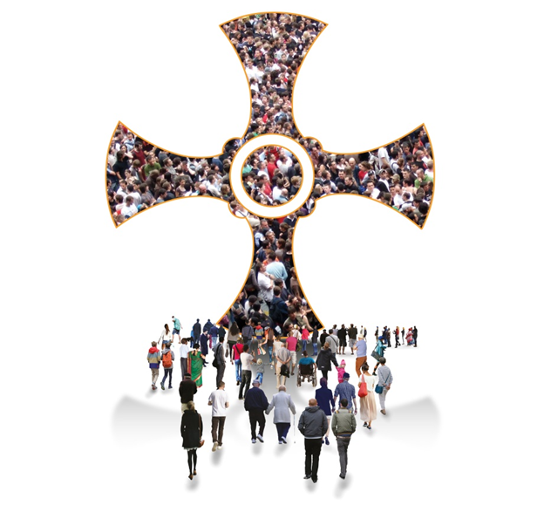
Proposals and Partnerships

Slide 8

The Challenge

Slide 9

The Challenge

Slide 10

In Practice…

Slide 11

Or perhaps…

Slide 12


Many hands…

Slide 13

Reviewing Partnership Proposals…
Everyone carries with them at least one piece of someone else’s puzzle.

Slide 14

Reviewing Partnership Proposals
Acknowledgement
Reviewers and allocation
Initial Review (Full week)
Presentation and Challenge
Modelling
Revisiting proposals
Write-ups
Rechecking…

Slide 15
Reviewing Partnership Proposals…

Slide 16
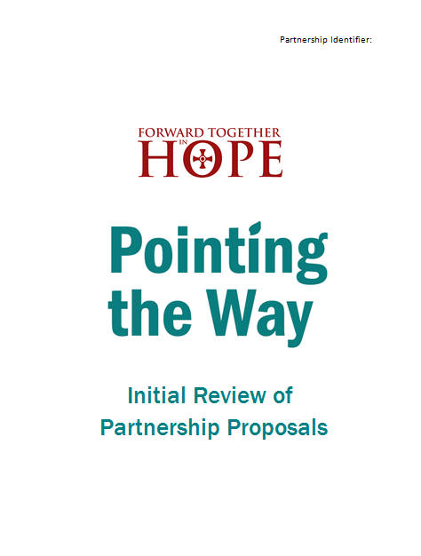
Reviewing Partnership Proposals…

Slide 17
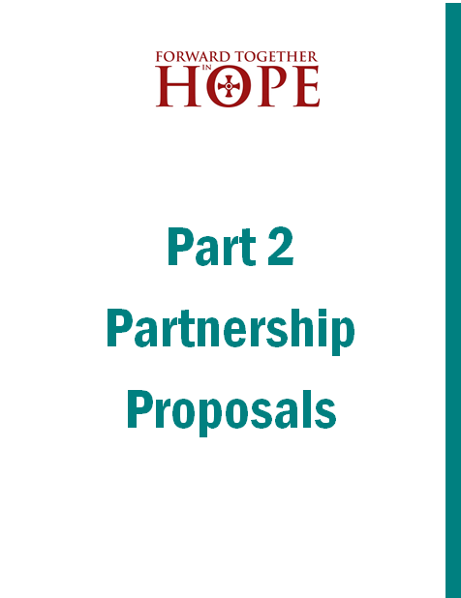
Reviewing Partnership Proposals…

Slide 18

Starting Points
Partnerships should serve the mission of the Church, helping people to become better disciples and reach out into the world.
Weaker parishes should be supported to flourish – and stronger parishes gain by doing so.
Partnerships should be sufficiently large to work well far into the future.

Slide 19
Starting Points
While needing to be flexible in terms of size and coverage there also needs to be a degree of consistency across the diocese as a whole.
Current boundaries and the current location of clergy should not restrict thinking about the future.

Slide 20
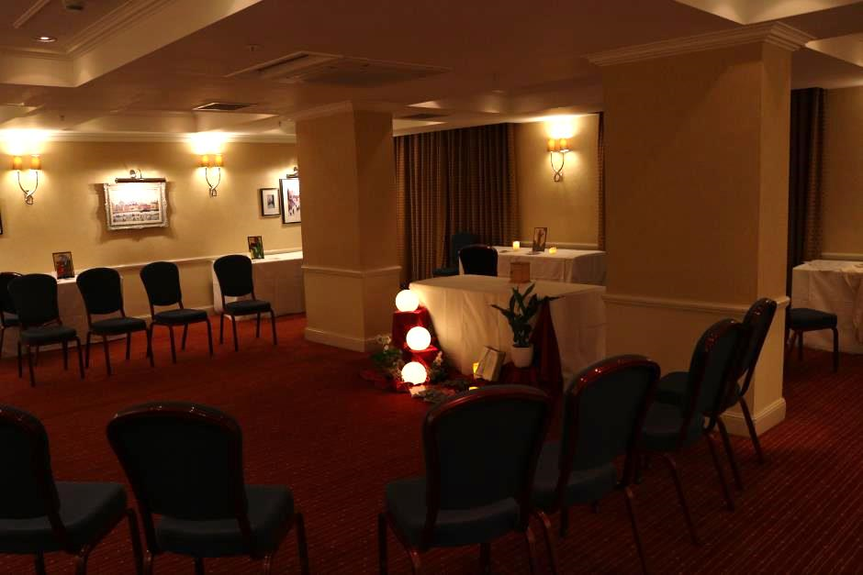
Starting Points

Slide 21
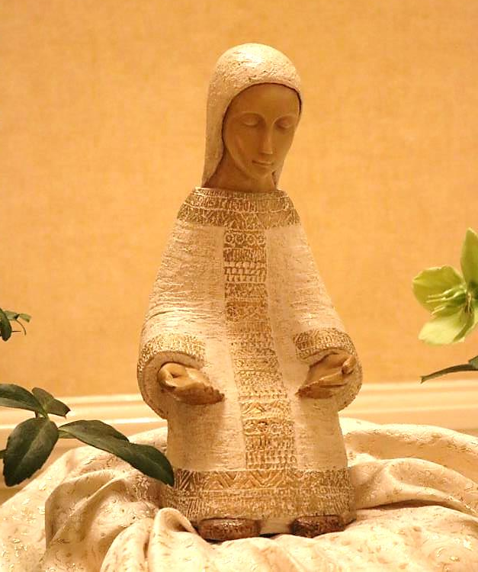
Starting Points

Slide 22

Be courageous -
and get on with it!

Slide 23
Proposals and Partnerships
Vicariate | Proposals
A: Northumberland | 4
B: Newcastle and North Tyneside | 6
C: South Tyneside and Gateshead | 8
D: Sunderland and East Durham | 5
E: Cleveland and South Durham | 4
Total | 27

Slide 24
Proposals and Partnerships
Vicariate | Proposals | Partnerships
A: Northumberland | 4 | 4
B: Newcastle and North Tyneside | 6 | 3
C: South Tyneside and Gateshead | 8 | 4
D: Sunderland and East Durham | 5 | 4
E: Cleveland and South Durham | 4 | 3
Total | 27 | 18

Slide 25
Proposals and Partnerships

Slide 26
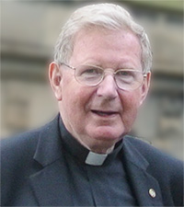

Partnership
‘A partnership is a group of parishes agreeing to work together, to share resources, both human and material, to become stronger and better equipped for furthering the Kingdom of God. They offer our diocese unlimited potential as we seek to ensure viable and flourishing communities of people who want to deepen their commitment to Jesus and witness to him in our world.’

Slide 27
Our new partnerships…
…offer opportunities to ensure that:
A range of formation programmes can be developed, at a more local level
Support can be made available for smaller communities.
The gifts, talents and financial resources in a wider area can be put at the service of more people.

Slide 28
Our new partnerships…
Priests can be freed to concentrate on their essential calling.
A thorough and careful review of property and its uses can be carried out throughout the area.
Opportunities can be found for people to come together across the area to celebrate and worship together.
Leadership teams including priests, deacons and people can develop to help everyone deepen their understanding of what it means to be a witness to Jesus in our world today.

Slide 29

Some Next Steps
Leaflet produced for everyone
Developing Partnerships – A Practical Guide
  ‘First Steps’ towards Partnership
  Key sections issued as required
‘Development Programme’
On-going communication

Slide 30

Your questions and comments…

Slide 31

Called to lead?

Slide 32
God of all Creation,
You have constantly poured out your Spirit upon our Diocese
and kindled here a light which has spread throughout the world.
Lord Jesus, you gathered disciples to yourself
to learn from you
and to model their lives on you.
Your Holy Spirit empowered them to continue your work in the world.

Slide 33

Come upon us, Holy Spirit,
deepen the faith you invite us to share
and inspire us to become faithful witnesses.
As we begin to develop our partnerships,
help each one of us to use the gifts you give us
to nurture one another,
to serve the world
and to live in harmony with the whole of creation.
All of this we ask in the name of Our Lord Jesus Christ.
Amen.

